Slide 1
Welcome to the United States Power Squadrons®
We ARE
America’s Boating Club®
For Boaters by Boaters

Slide 2
OUR MISSION
Saving lives on the water by providing boater education

Slide 3
DPSPS NEW MEMBER ORIENTATION
What you need to know now
    Benefits we offer
    Fun stuff we do
    Education we offer
    Opportunities for service

Slide 4
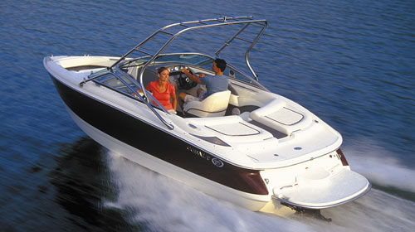
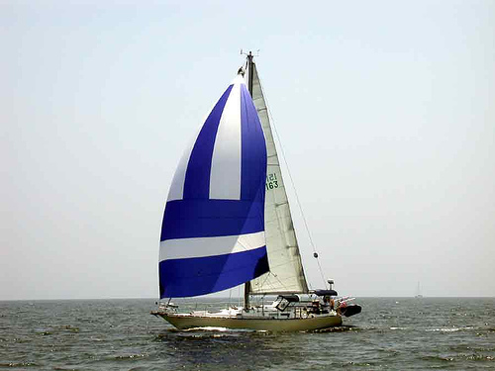
Who Are We?
Over 30,000 members nation wide
Teach/learn boating skills
Engage with boating friends
Connect with the boating community

Slide 5
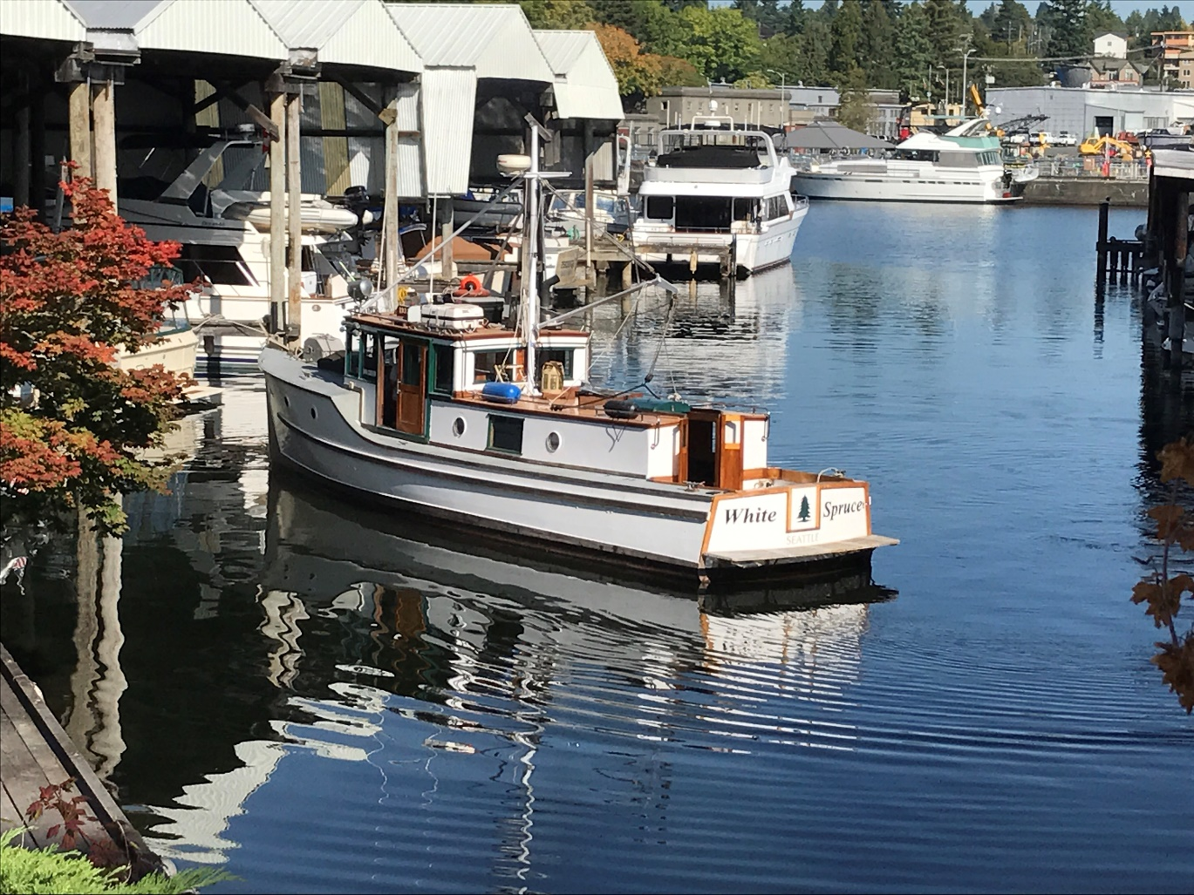
White Spruce, 1932

Slide 6

United States Power Squadron Early History

Slide 7
United States Power Squadron Early History
October 1912: Boston Yacht Club Rear Commodore Roger Upton petitioned the Executive Committee to officially establish a, “Power Boat Division”
January 1913: Name changed to "Power Squadron"
  United States laws governing navigation applied only to steam vessels, governed by a board of steamboat inspectors who were old, crusty, sea-going men
  Franklin Delano Roosevelt, then assistant secretary of the Navy and an honorary member of the Boston Yacht Club, had observed Power Squadron drills

Slide 8
United States Power Squadron
Then & Now
World Wars I & II: FDR (as Assistant Secretary and again as President)
  Volunteered the entire USPS instructional program for the training of men for naval coastal defense (477 members, 20 Squadrons)
  Schools were organized by local squadrons in New York City, Boston, Detroit, Newburgh, New Haven and Washington, D.C.
  Over 8,000 men who attended these classes entered the armed services and, based in significant part on the quality of their USPS training, many were appointed officers
  A parallel organization, Canadian Power and Sail Squadrons, with which we maintain close cooperation, flourishes in Canada

Slide 9
United States Power Squadron
Then & Now
September 1989: President George Bush signed a proclamation honoring USPS
Today: Started as a club-within-a-club in the early 1900s, USPS today is a private, self-supporting, non-profit, fraternal boating organization with an incomparable record of achievement
  No other enterprise can boast of more dedicated or more productive members who have given generously of their time and resources to educate each other in all aspects of boating, and to promoting the cause of safe boating through public courses and other civic services
  A roster of seven squadrons in 1914 has now grown to well over 450 units operating in the continental United States, Hawaii, Puerto Rico, and Japan

Slide 10
DPSPS Organization
National
Districts
Local squadrons

Slide 11
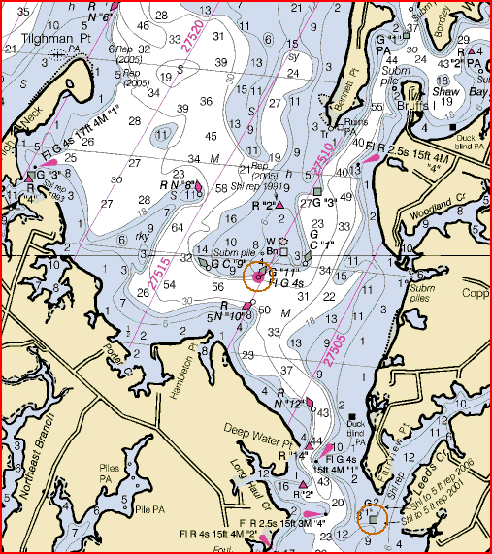
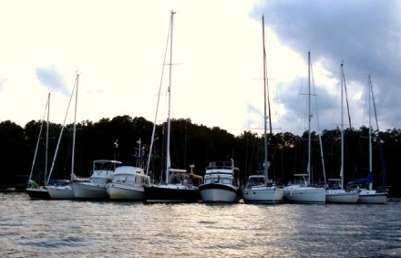
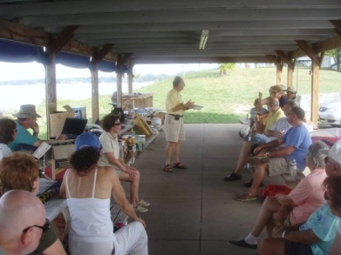
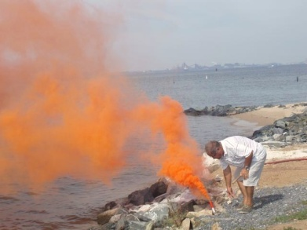
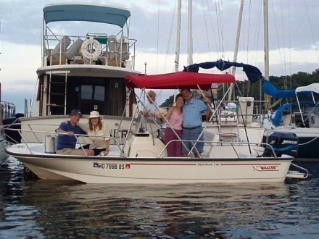
United States Power Squadrons®
We offer a wide variety of activities
  Boating courses & seminars
  On-the-water training & events
  Social gatherings
  Vessel safety checks
  Safety training
  Cooperative Charting
  Boating community interaction

Slide 12
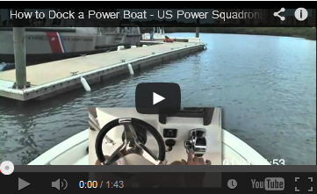
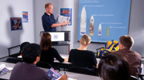
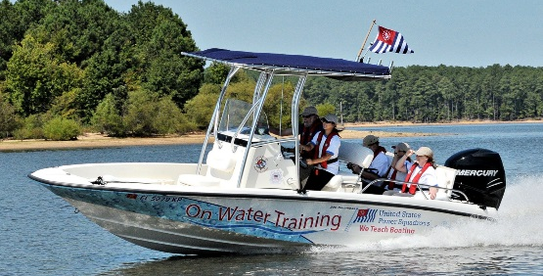
Boating Education Your Way
On-line courses
  Convenient
  At your own pace
Classroom
  Certified instructors
  In-depth answers to your questions
  Group learning and interaction
  Realistic presentations
On the Water
  Hands on training
  Skills development

Slide 13
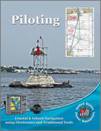
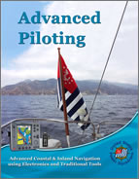
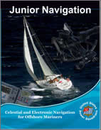
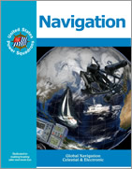
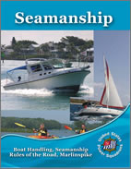
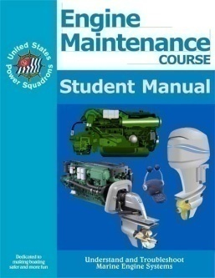
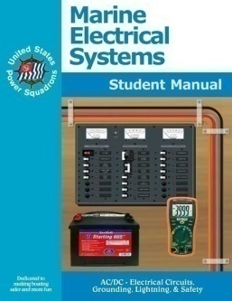
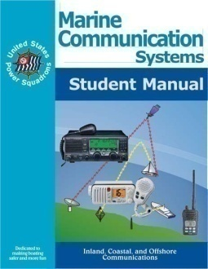
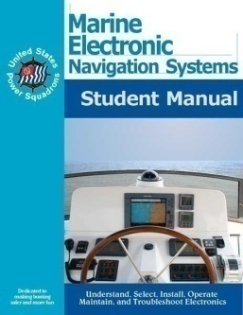
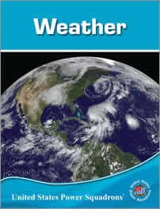
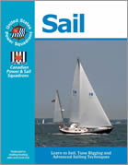
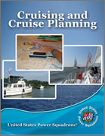
Courses
Navigation
  Inland and Coastal
  Offshore
Boat Handling
Marine Equipment
Weather
Sail
Cruise Planning

Slide 14
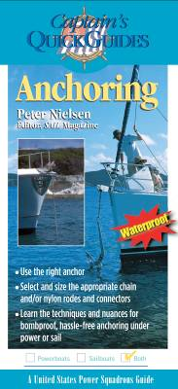
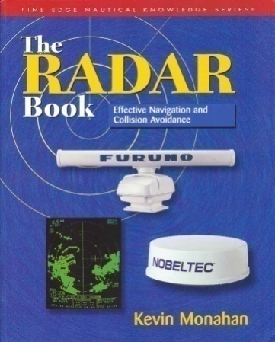
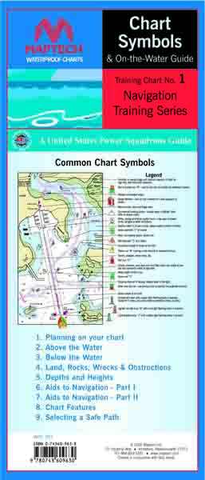
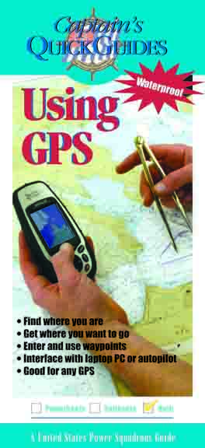
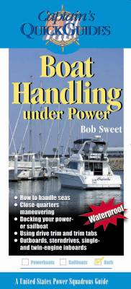
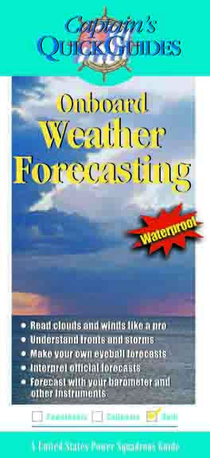
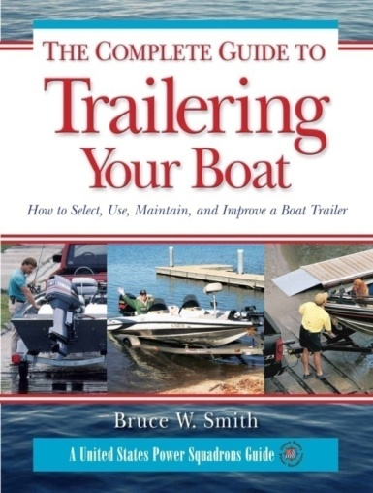
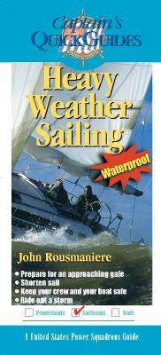

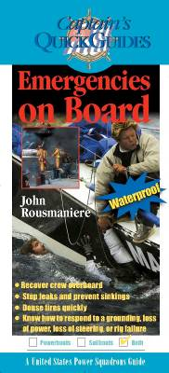
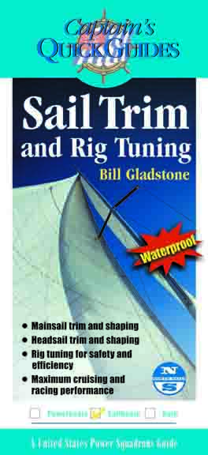
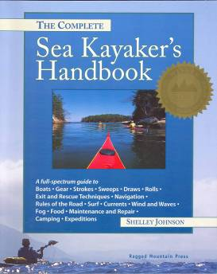
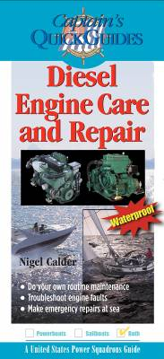
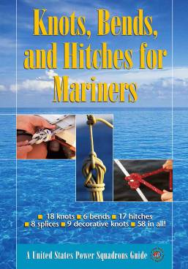
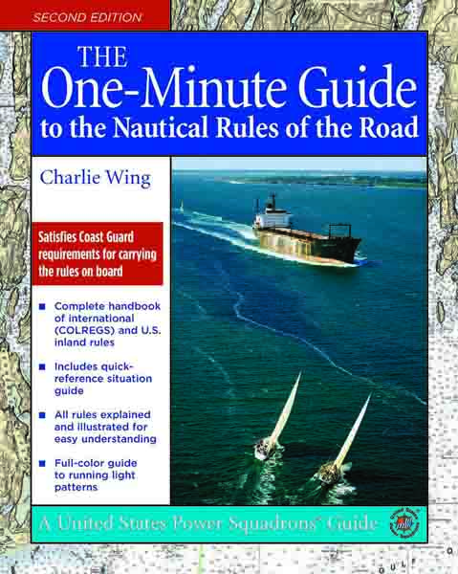
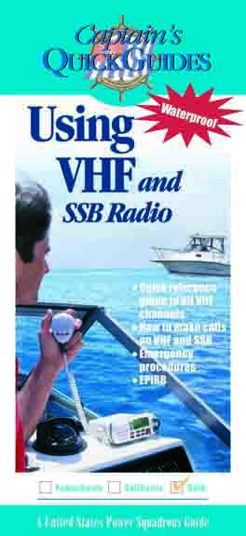
Two Hour Seminars

Slide 15
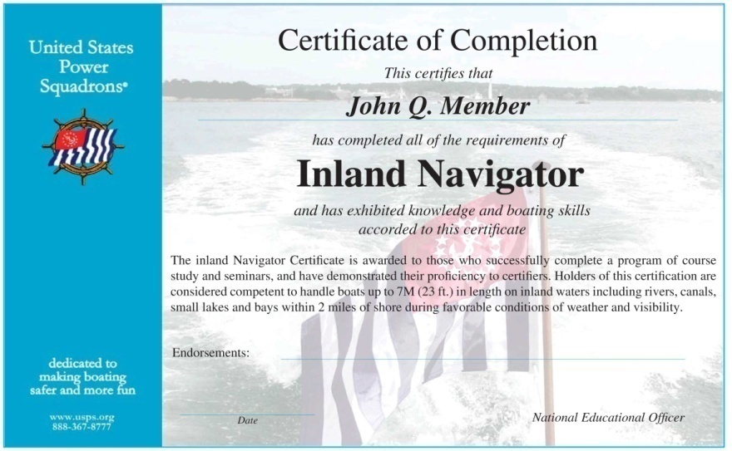
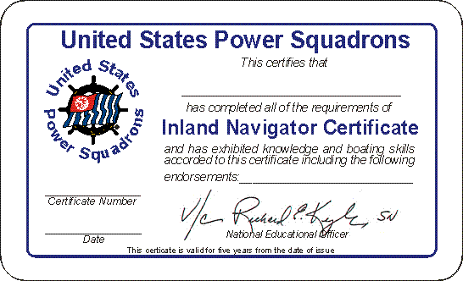
Boat Operator Certification
Boating Credentials
  Inland
  Coastal
  Advanced Coastal
  Offshore
Seminars
  Credit toward certification

Slide 16





Save on Boat Insurance
Insurers offer greater savings to those who take member courses
  Save as much as 23% on insurance premiums
  Among others

Slide 17








Save on Boating Products
  Charts and Marine Books
  Boating Equipment
  Software
  Computers
  Insurance
  Literature and Courseware
  Publications

Slide 18
National Benefits, online seminars and courses, etc. can be found on
Americasboatingclub.org

Slide 19
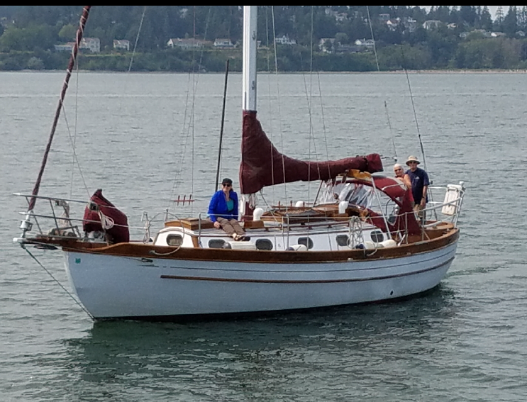
Capella, 1979 Flying Dutchman
(Mike McGill/Carolyn Brady)
Baba 35, Capella

Slide 20
District 16
District 16 consists of 15 squadrons in Washington and Alaska
District 16 leadership provides guidance, data, conferences, & coordination among squadrons
DPSPS Part of District 16

Slide 21
District 16 Member Benefits
Office Depot/Office Max
Farmers www.uspsd16.orgInsurance
Fisheries Supply
Waggoner Cruising Guides & Store
Travelers Insurance
Boat U.S.

Slide 22
District 16
See www.uspsd16.org for,
        Member benefits
        Link to other squadrons in area
        Courses & Seminars offered locally
        Membership information
        Vessel Safety Checks
        News & Events

Slide 23

History of DPSPS
Began as a branch of Bellingham Power Squadron
Chartered as a Squadron in 1976
Changed our name in 2003 to “Sail and”
Geographic area is Whidbey + Fidalgo Islands

Slide 24
Deception Pass Sail & Power Squadron
Typical yearly Educational Activities
Two American Boating Courses (ABC)
Two Boat Handling Courses
One or two Piloting Courses
Partner in Command seminar
Shrimping and Crabbing seminars
Cruising North seminar
Boating Safety for Kids
Other advanced courses and seminars as requested

Slide 25
2020-2021 Education Schedule
Tentative Plans
America’s Boating Class: Oct & March/April
Boat Handling Course: Nov & March/April
Piloting: Winter
Seminars:
  Cruise Planning, Spring, 2021
  Shrimping Seminar, April 2021
  Crabbing Seminar, June 2021
  Boating Safety for Kids, Quarterly

Slide 26
SEMINARS WE OFFIER
    Boating Safety for Kids
    Docking & Undocking
    Partner in Command
    Crabbing 101
    Shrimping on Whidbey
    Rules of the Road
    Anchoring with Assurance
    Boating with Confidence
    Emergencies Onboard
    Knots and Line Handling
    Federal & State Safety Requirements
    Required Safety Equipment

Slide 27
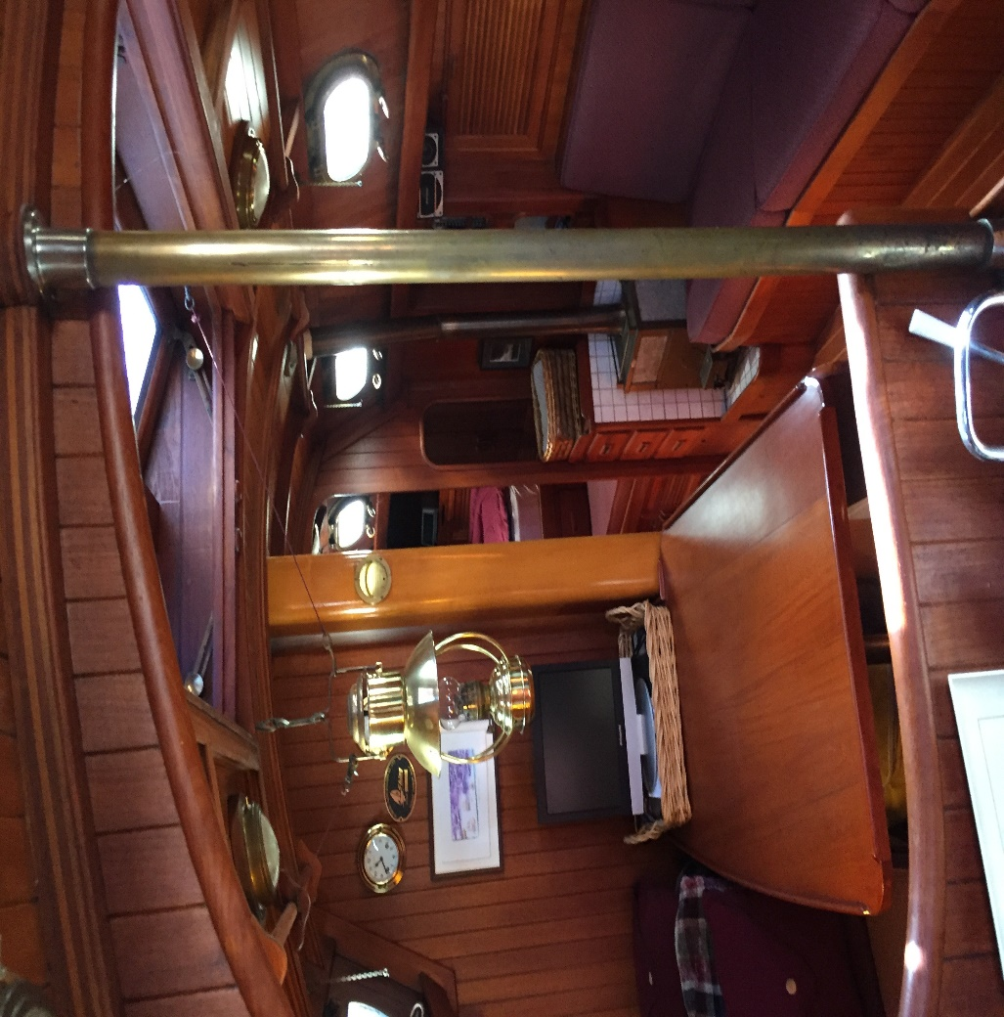
Capella, 1979 Flying Dutchman
(Mike McGill/Carolyn Brady)
Baba 35 Capella

Slide 28
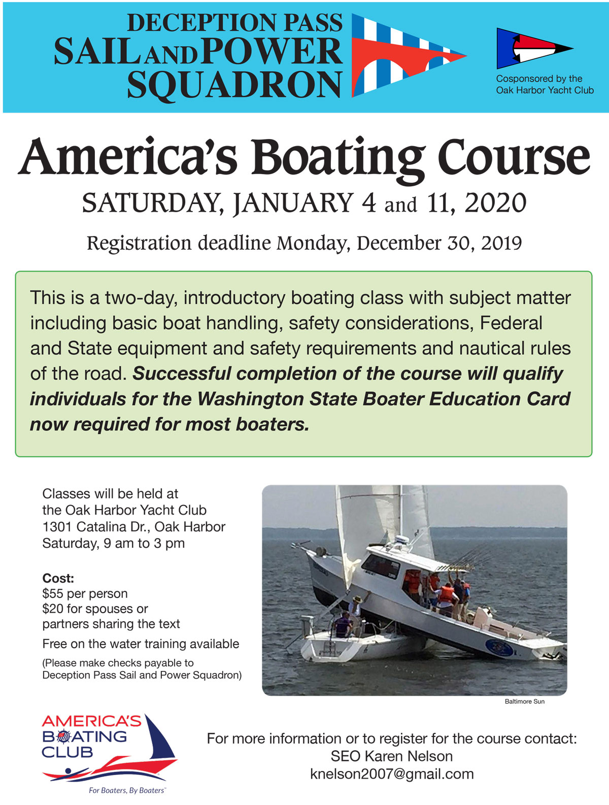

Slide 29
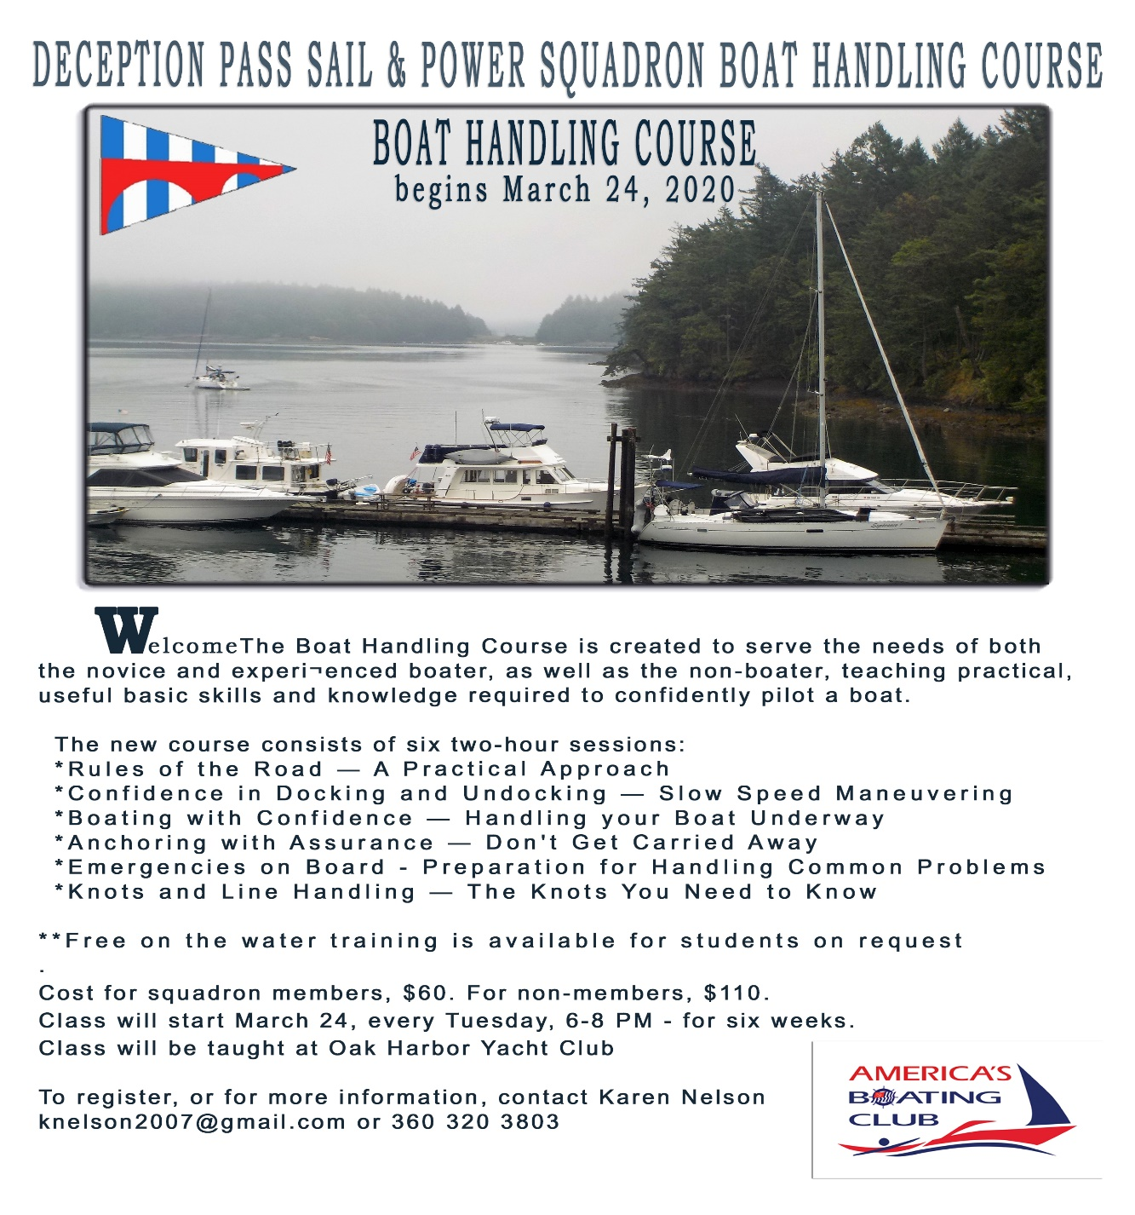

Slide 30
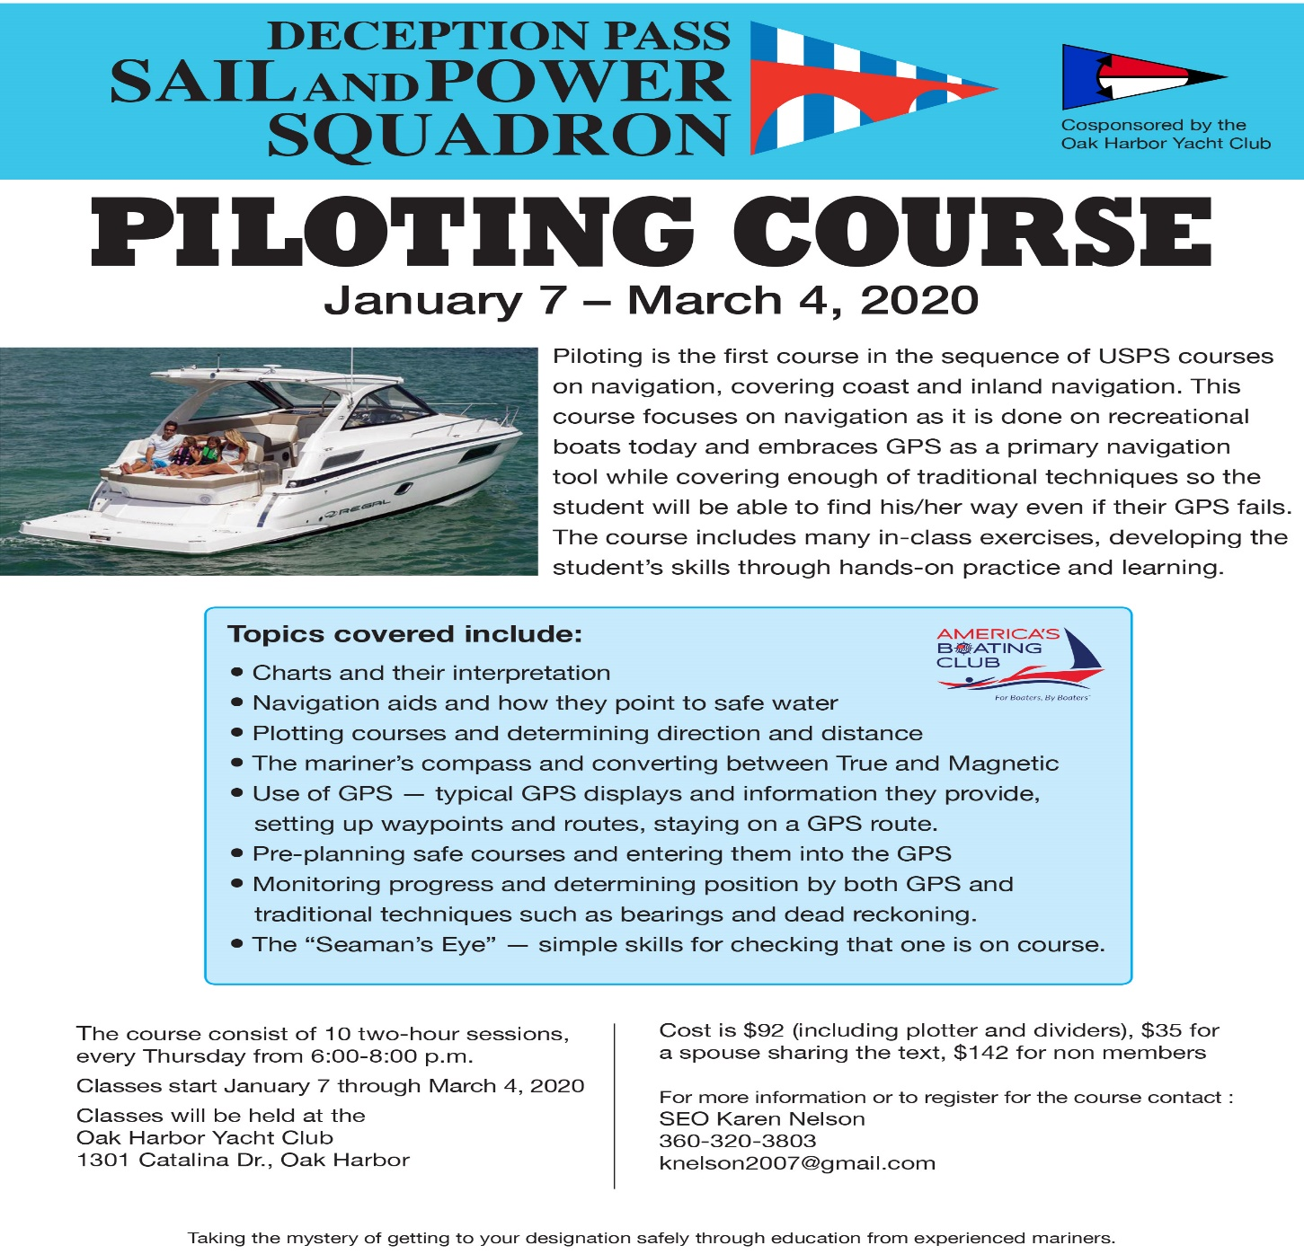

Slide 32
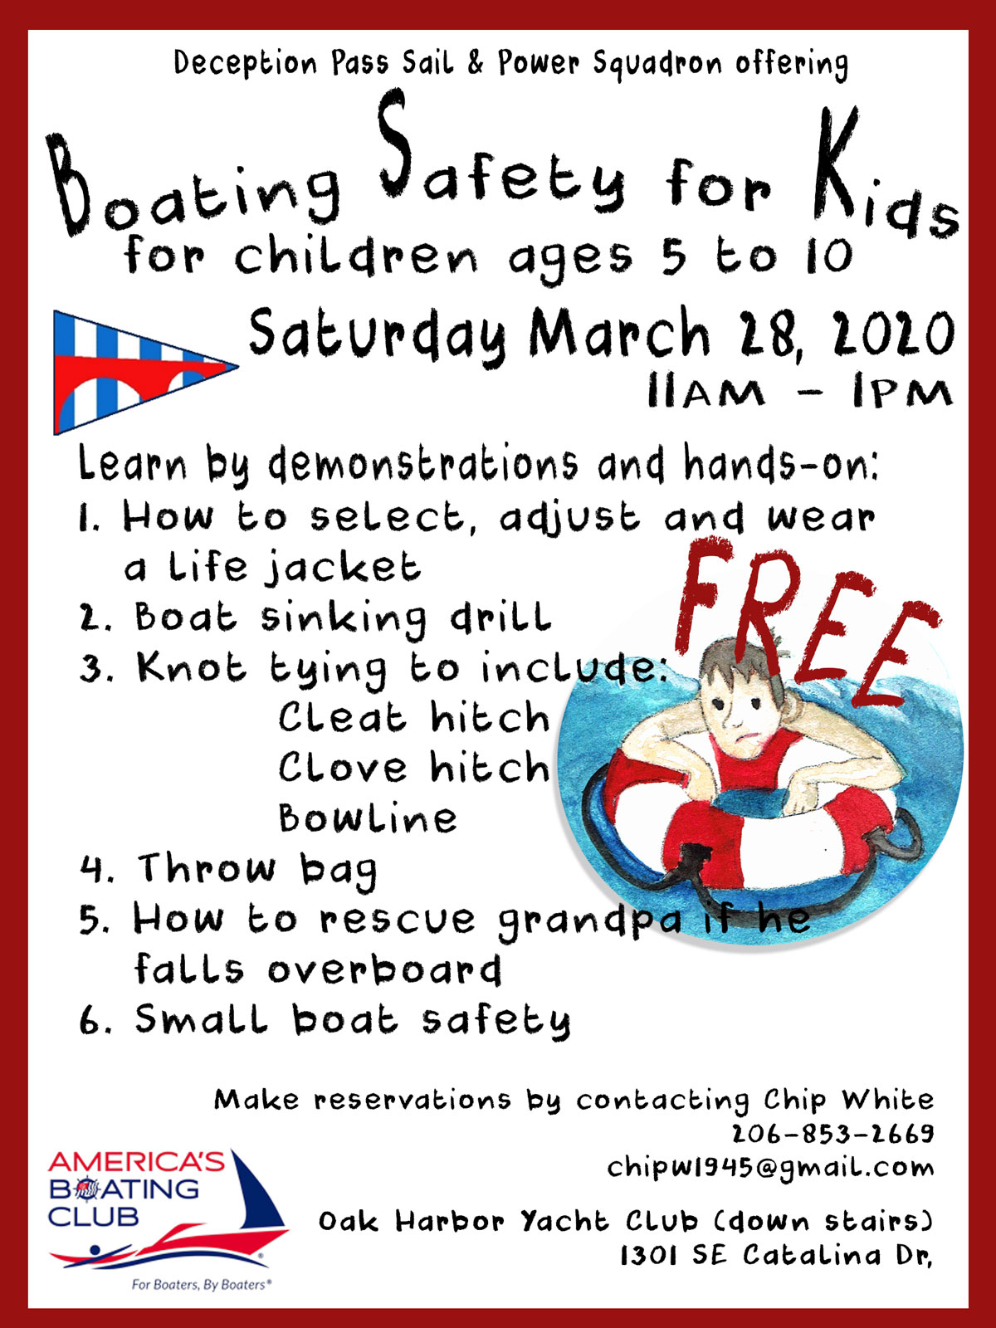

Slide 33
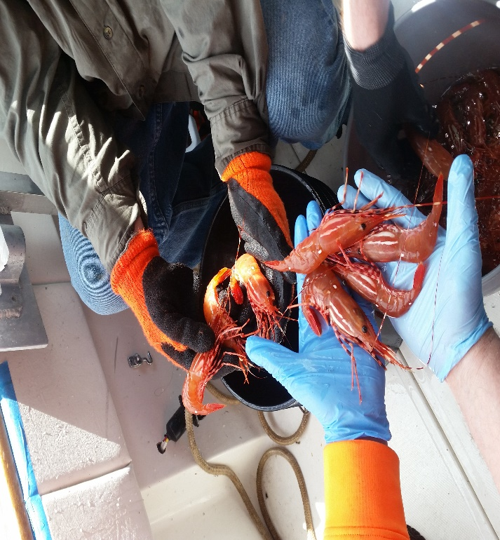
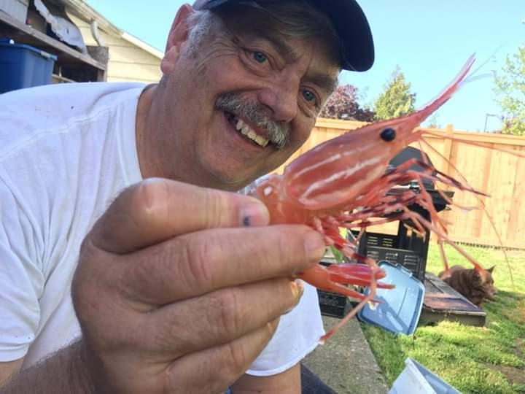
Shrimping Seminar!

Slide 38
FUN STUFF!
Jamboree
Swap meet
Dinner Speakers
Cruises
Seminars
Socials
Parades
Kids Safety events

Slide 39
Squadron Meetings
Dinner meetings - 2nd Thursday, Sept to May
Excom meetings - Aug to May
Business meeting and elections - March
Change of Watch – April
Marine Swap Meet & Jamboree – Spring
Squadron picnic - traditionally August or Sept
Holiday Banquet - December

Slide 40
TYPICAL DINNER SPEAKERS
Michael Powers, Tragedy and survival in Deception Pass!
Ralph & Colette Gamble, Cruising to El Salvador
Anthony Zumpano, US Border Protection Port Director, New Boating Requirements for Private Boaters, called ROAM
Annette Ferguson, D16 Commander
Curt Adams, Bristol Yachts Northwest, The buying and selling of vessels.

Slide 41
Deception Pass Sail & Power Squadron
2020-2021 Planned Activities
SERAT
Over 100 Vessel Safety Checks
Co-op Charting
Civic Service activities
Jamboree
Marine Swap Meet
Boat Show Booths
Holland Happenings parade
membership meetings
Cruises with Oak Harbor Yacht Club

Slide 42
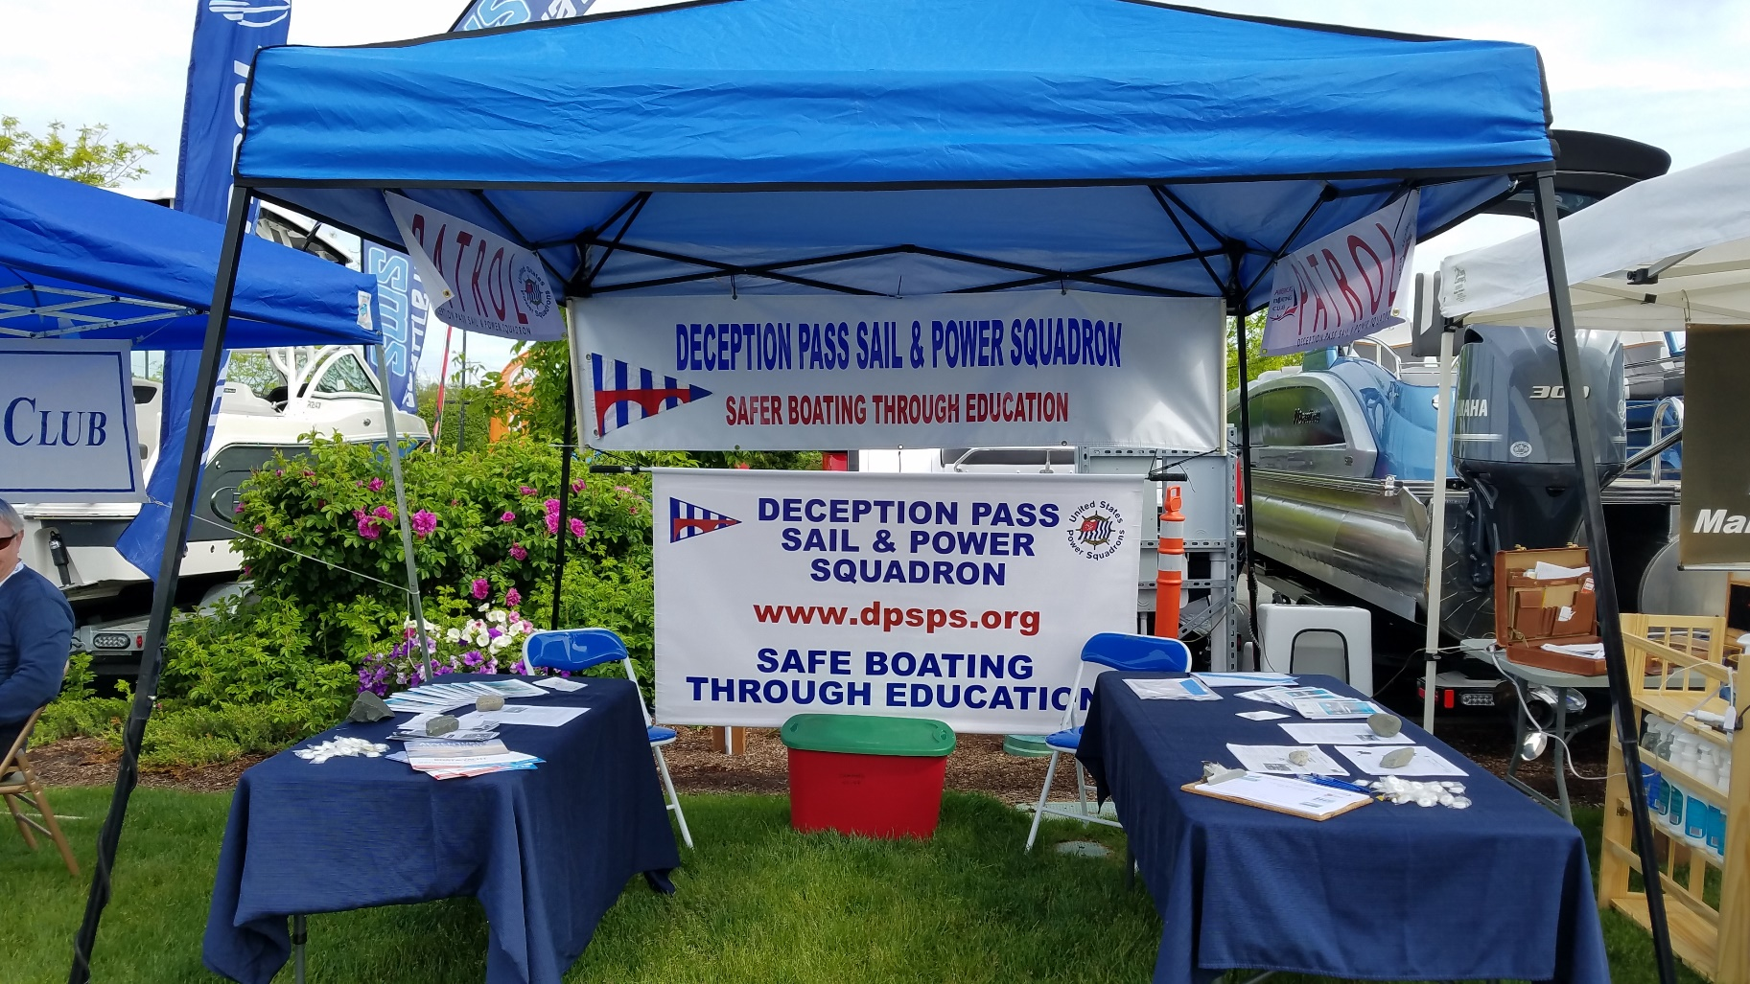
Anacortes Boat Show

Slide 43
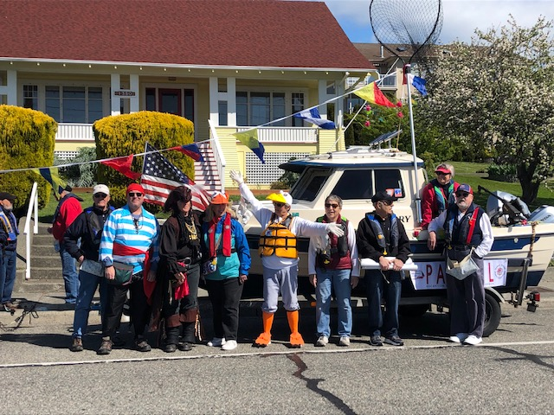

Holland Happenings!

Slide 44

Our favorite Pirate!

Slide 45


Change of Watch

Slide 46
2020-2021 Squadron Officers
Commander Cdr Pat Waters, JN
XO Lt/C Shawn Haugen
SEO Lt/C Steve Pye, AP
Admin Lt/C Bob McCrary, S
Secretary open
Treasurer Lt/C Mike McGill, S
Membership Lt Hiller West, S
ASEO Lt Reg White, P
Marketing Lt Jennifer Geller, P
Boating Lt Bob Nelson, JN
Safety Lt Jerry Liggett, P

Slide 47
2020-2021 Squadron Officers
Members-at-Large
P/Lt/Cdr Jim Wagner, AP
P/Cdr Mark Casteel, AP
Fred Lemke, JN

Slide 48
Committee Chairs
2020-2021
Rules/Bylaws Bob Nelson, JN
Coop Charting Mark Casteel, AP
Nominating Jennifer Geller, P
Hiller West, S
Safety Checks Mark Casteel, AP
SERAT Bill Coltrin, S

Slide 49
Other Chairs
2020 - 2021
Membership Hiller West, S
Ops Training Steppe Williford, JN
Newsletter Sue Waters
Website Sue Waters
Facebook Paula Mihok

Slide 50
Key Resources
National Website (http://www.usps.org/)
District 16 Website (https://www.uspsd16.org/)
Squadron Website (https://www.deceptionpasssailandpowersquadron.com)
Squadron Officers
Past Squadron Officers
Mentors
Spindrift
Member contact info under Member info on DPSPS website

Slide 51
Membership Number & Pin
Each new member is assigned a membership number.
That number is on your membership certificate. SAVE IT!!
You need it to enroll in courses
Also you are given a Pin number.
Need Pin number to access member websites. SAVE IT!!

Slide 52


United States Power Squadrons®
WWW.USPS.ORG
Deception Pass Sail & Power Squadron https://www.deceptionpasssailandpowersquadron.com
And follow us on:

Slide 53
What’s Next?
  Questions
  What is missing?
  What did you like?
  What did you think needs improvement?
  Discussion
      What do you need now from DPSPS?

